Slide 1
Multi-dimensional seismic reconstruction
Yangkang Chen

Slide 2
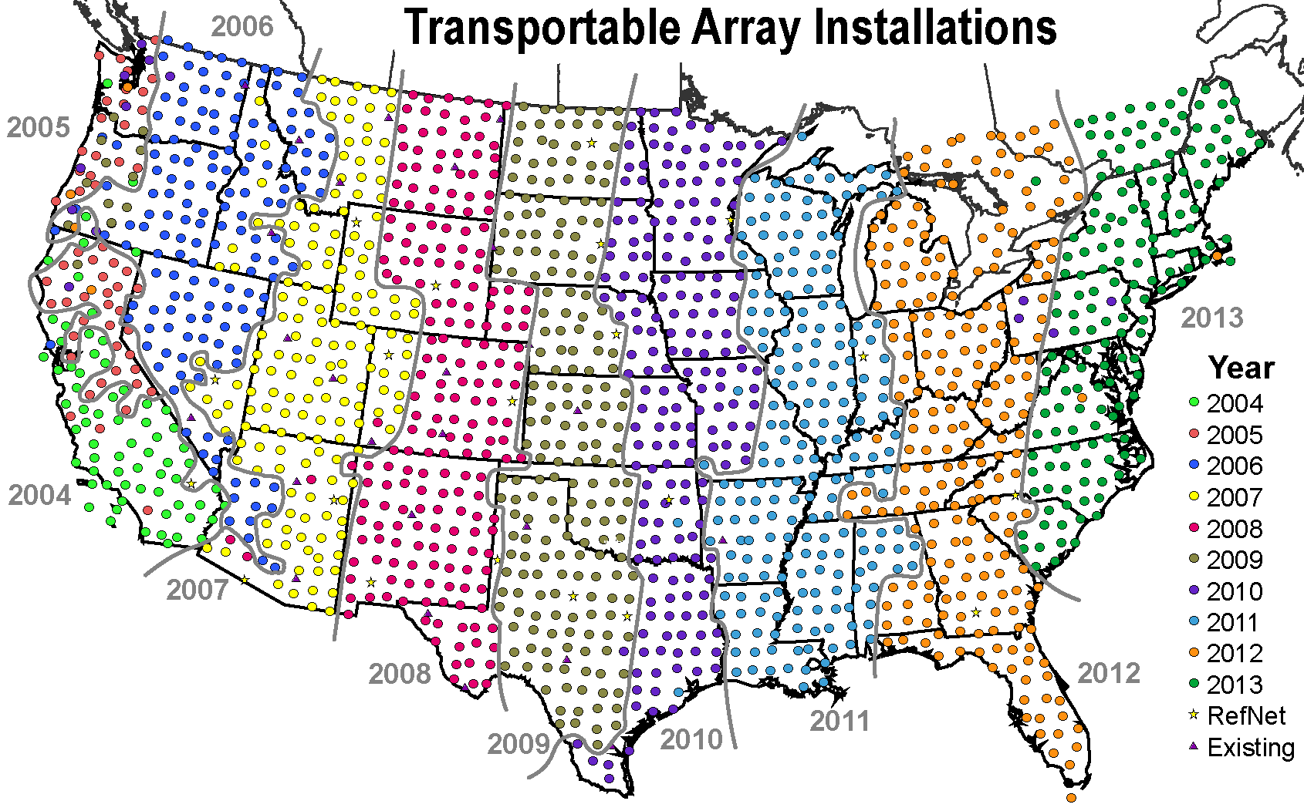
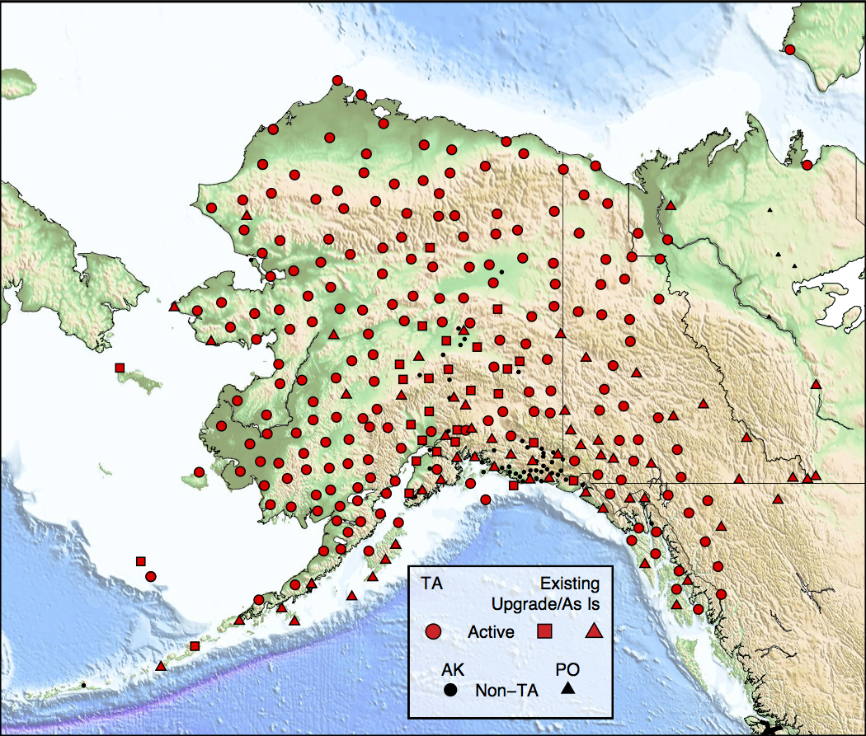
Reconstruction USArray data
USArray a pioneering project for the dense acquisition of earthquake data.
It provides a semi-uniform sampling of the seismic wavefield beneath its footprint and greatly advances the understanding of the structure and dynamics of Earth.
Despite continuing efforts in improving the acquisition design, network irregularity still causes spatial sampling alias and incomplete, noisy data, which imposes major challenges in array-based data analysis and seismic imaging.
Since 2014
Notes:
Comparisonofseveralprocessingstrategiesforreceiverfunction

Slide 3
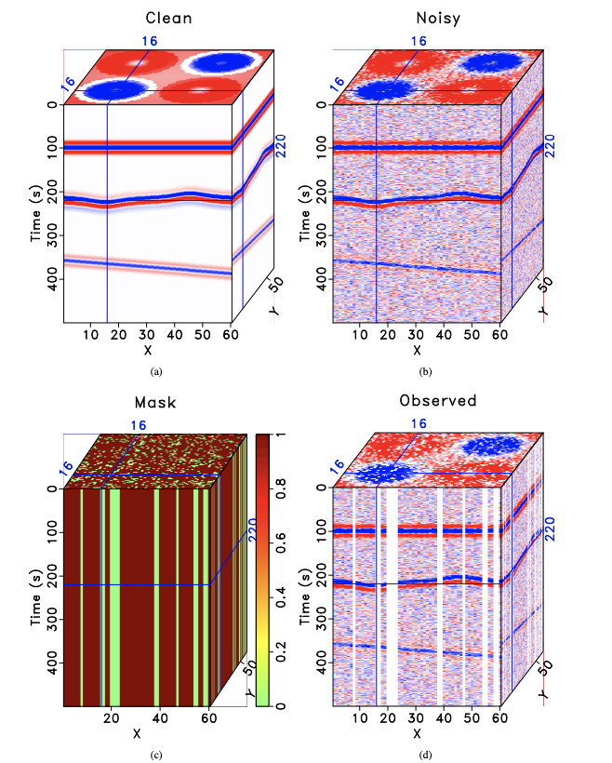
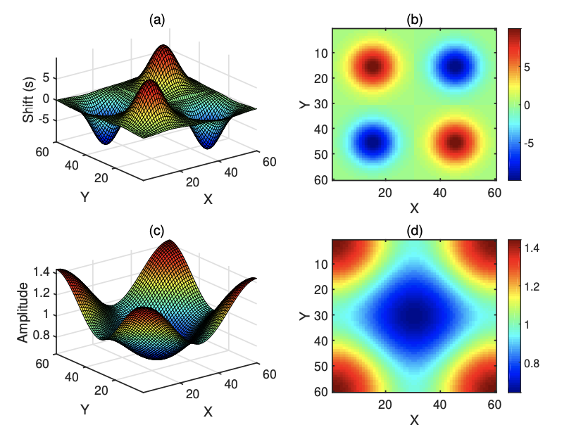
Synthetic example I
Chen et al., 2019

Slide 4
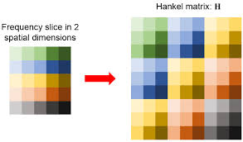
Rank-reduction filtering
Block Hankel matrix
1. It is a filter.
2. Assumption: plane waves
3. It is implemented in each frequency slice.
4. Three steps for each frequency slice
Hankelization
Truncated SVD
Averaging
Frequency slice in 2 spatial dimensions

Slide 5
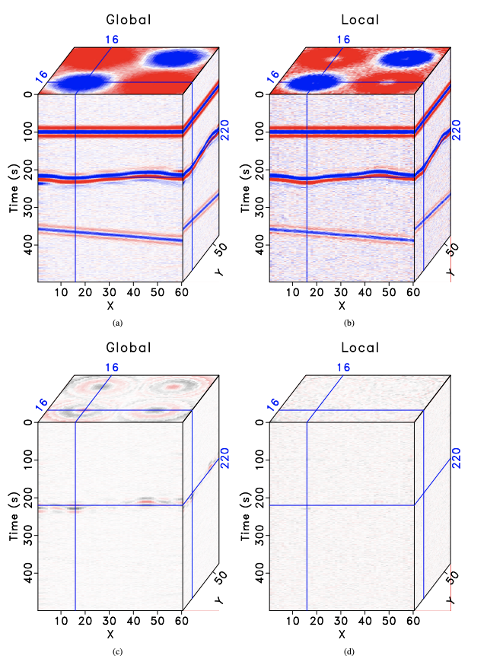
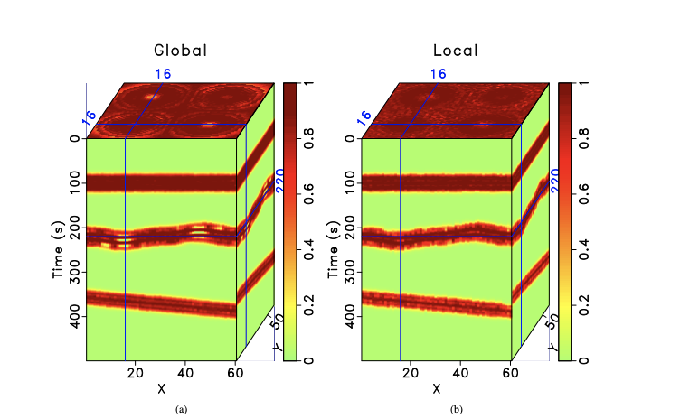
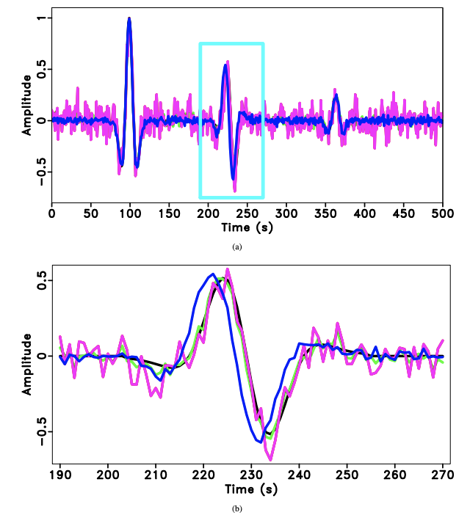
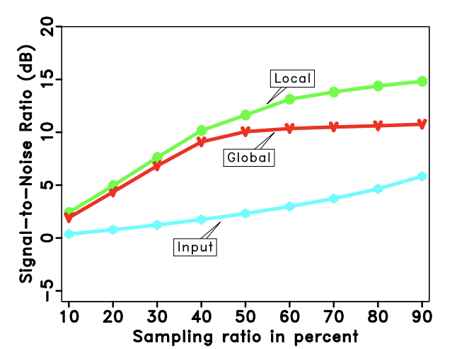
Synthetic example I
Chen et al., 2019

Slide 6
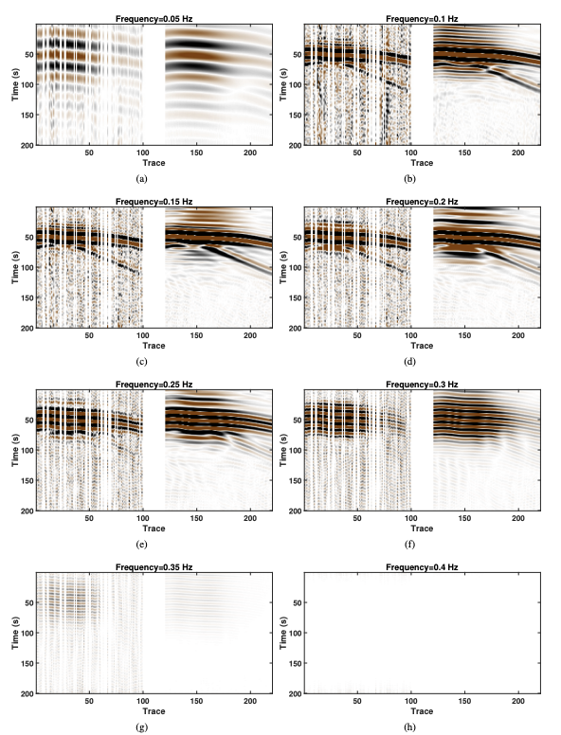
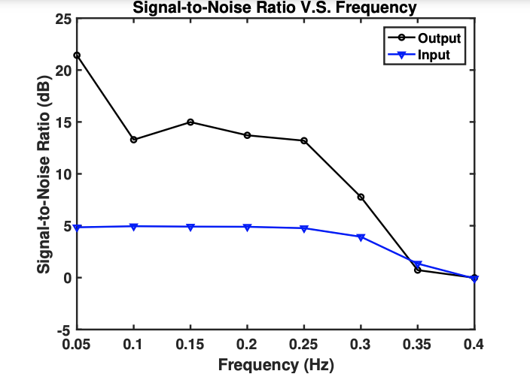
Synthetic example I
Chen et al., 2019

Slide 7
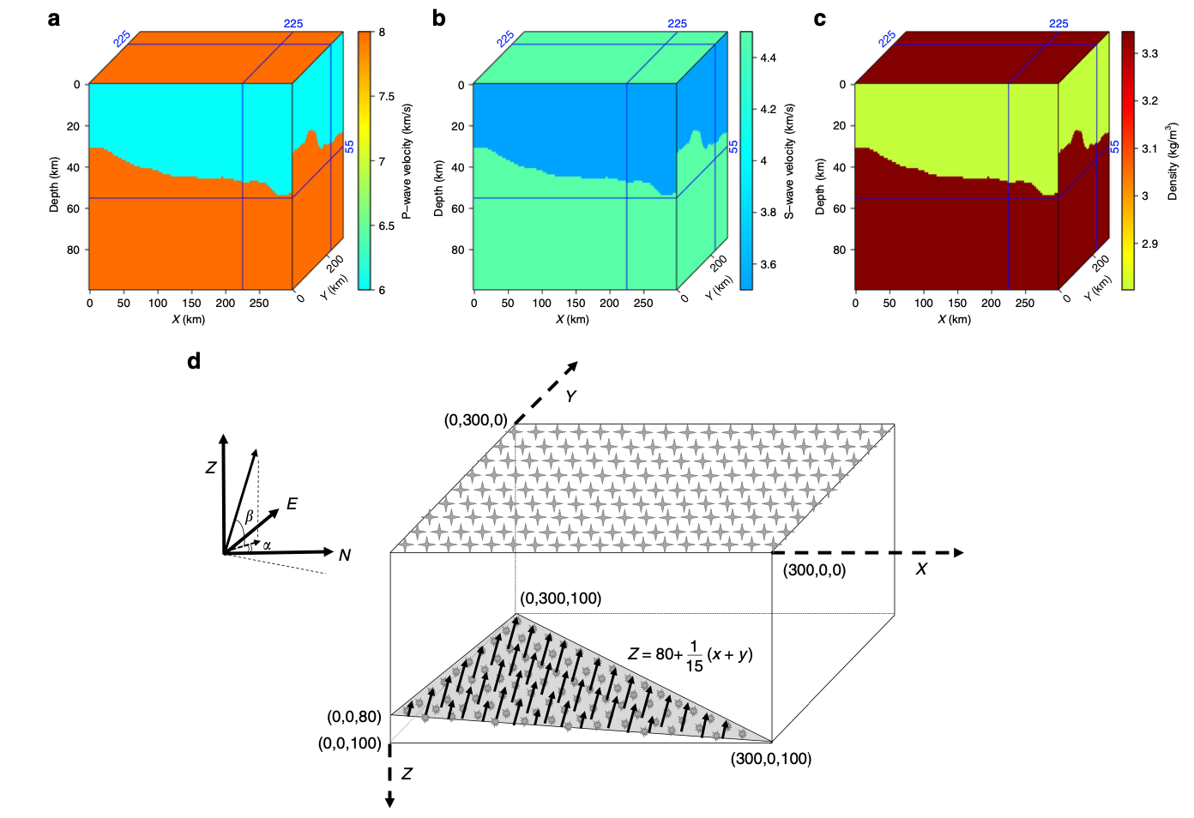
Synthetic example II
Model size: 100x100x100 (nz,nx,ny)
Data size: 200x100x100 (nt,nx,ny)
dz=1km,dx=3km,dy=3km
dt=0.5s
Modeling method: 3D first-order elastic wave equation (staggered-grid finite difference)
Parallel method: GPU acceleration
Chen et al., 2019
Notes:
Wavefield simulation of plane-wave incidence beneath a regional array. The synthetic model is constructed using real Moho constraints37 and elastic parameters of a P-wave velocities, b S-wave velocities, and c densities from a 1D reference model38. The blue lines mark the location of horizontal and vertical slices, where the values of model parameters are demonstrated and projected onto the corresponding sides of the model cube. d Observation system demonstrating the positions of planar source and receivers. The stars at the surface denote the evenly distributed receivers and symbols on the dipping plane denote the injected source positions

Slide 8
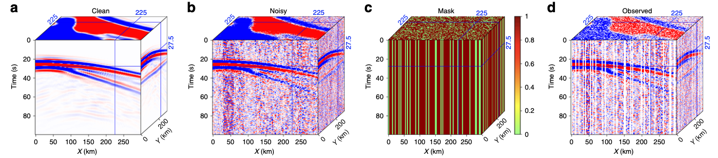
Synthetic example II
The P-wave from earthquake data is chosen as the wavelet
Added noise is real noise from earthquake data
Chen et al., 2019
Notes:
The vertical component of the synthesized data. a The clean data obtained from elastic wave simulation. b The noisy data with signal-to-noise ratio equal to 10.12 dB. c The sampling matrix with a sampling ratio of 70%. d The final data (signal-to-noise ratio equals to 4.35 dB) after applying the sampling matrix to noisy data in (b)

Slide 9
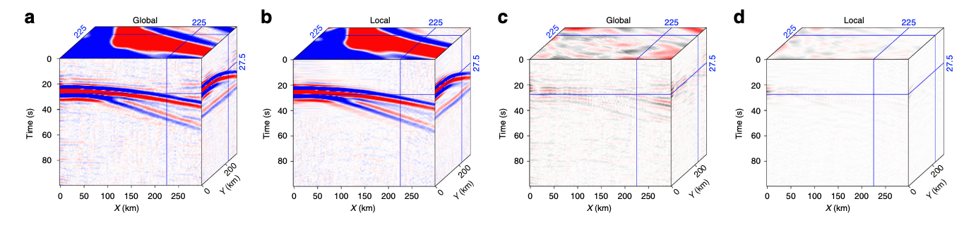
Synthetic example II
Global method
Local method
Global method
Local method
Chen et al., 2019
Notes:
Synthetic test results. a Reconstructed data using the global rank-reduction method. The signal-to-noise ratio of the reconstructed data is 17.34 dB. b Reconstructed data using the localized rank-reduction method (signal-to-noise ratio is 21.53 dB). c, d Reconstruction errors corresponding to (a, b)

Slide 10
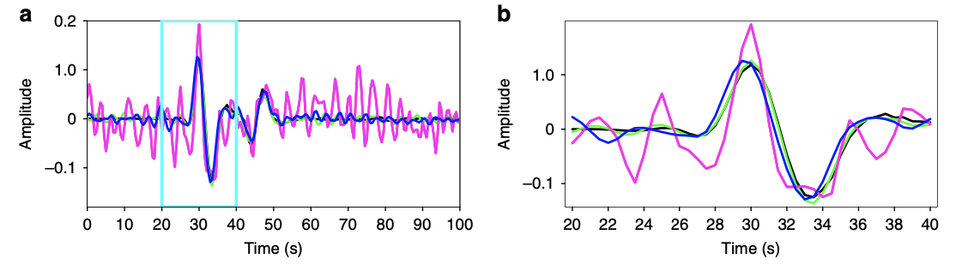
Single trace amplitude comparison
Noisy
Global
Clean
Local
Chen et al., 2019
Notes:
Comparison of the single trace amplitude (X = 225, Y = 225) in different scales. a Comparison in the original scale. b Comparison in the zoomed-in scale. The black and pink lines represent clean and noisy data, respectively. The trace processed using global and localized rank-reduction methods are shown by the blue and green lines, respectively. The black line (exact solution) is almost completely overlapped with the green line (localized reconstruction), indicating that the error of reconstruction is minimal for the proposed approach

Slide 11
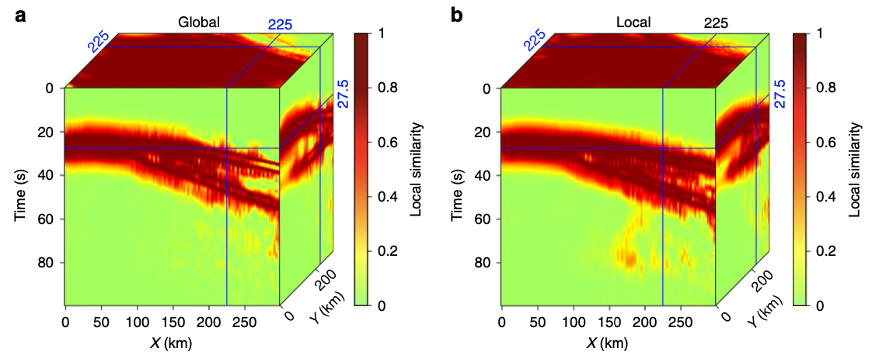
Local similarity
Global method
Local method
Chen et al., 2019

Slide 12
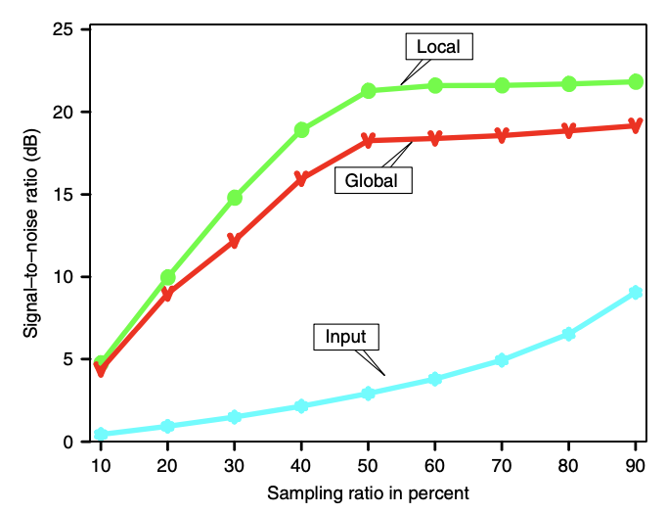
SNR
Chen et al., 2019
Notes:
Reconstruction results at different sampling ratios. The reconstruction performance (signal-to-noise ratio) improves with the increasing sampling ratio. The localized rank-reduction method always outperforms the global algorithm

Slide 13
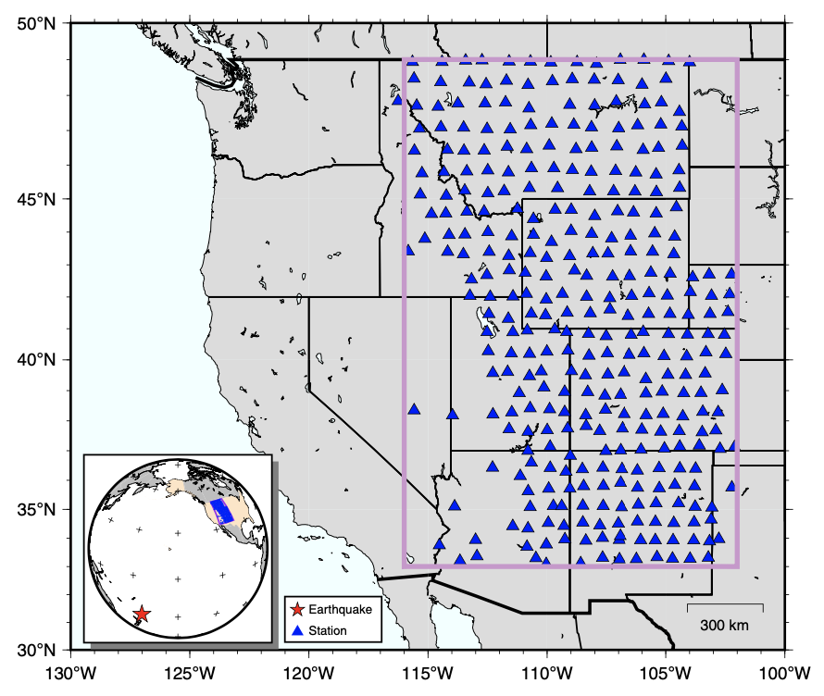
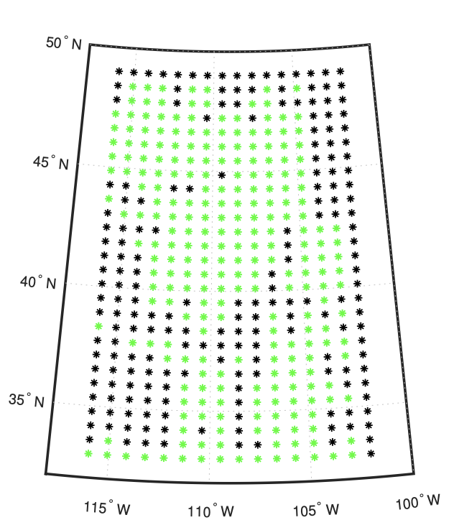
USArray data
Binning
Sampling matrix
Samples
Missing
Regular grids
Stations
Chen et al., 2019

Slide 14
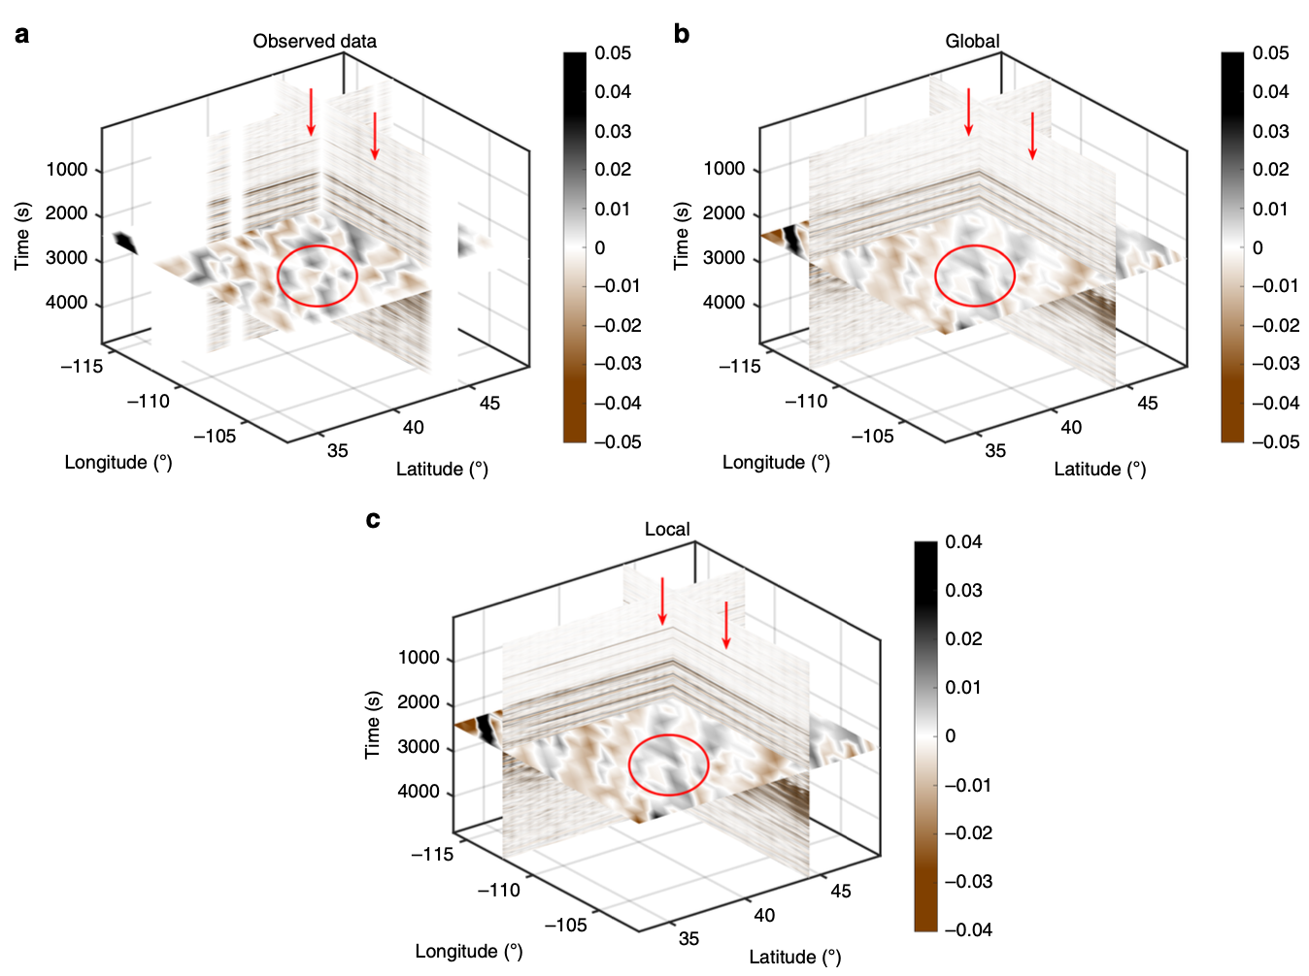
Comparison of reconstruction results
Window size (2000 samples)
Chen et al., 2019
Notes:
A 3D view of the earthquake data recorded by USArray analyzed in our study. a Observed data on a regular grid. The circled area shows the region with poor spatial sampling. The red arrows indicate the weak-amplitude P-wave arrivals contaminated by the noise. b Reconstructed data using the global rank-reduction method. c Reconstructed data using the localized rank-reduction method

Slide 15
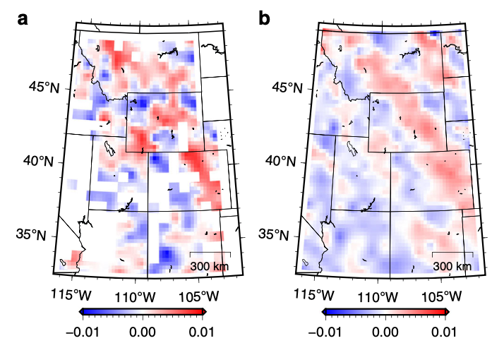
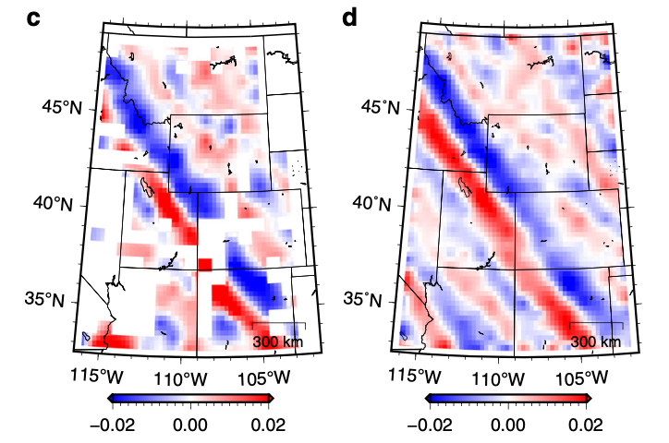
Comparison of reconstruction results
Raw
Reconstructed
Raw
Reconstructed
Chen et al., 2019
Notes:
A comparison of reconstruction results between different time slices. a The time slice corresponding to t = 1200 s of observed USArray data. b The time slice corresponding to t = 1200 s of reconstructed USArray data. c, d The same as (a, b) but for time slice at 2100 s. The clear phase arrivals are reconstructed in the SW corner of the seismic array

Slide 16
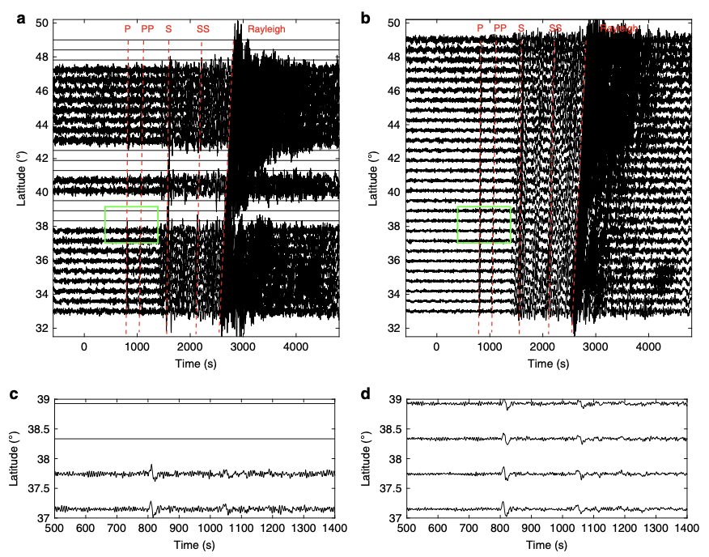
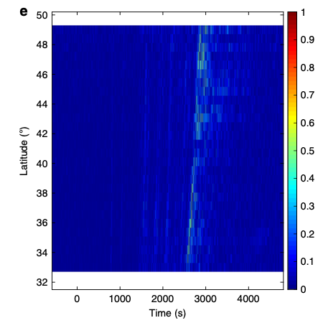
Comparison of reconstruction performance
Chen et al., 2019
Notes:
A detailed comparison of reconstruction performance along with a longitudinal slice (longitude = 107.6°W). a Raw waveforms before reconstruction. b Reconstructed waveforms. The main phase arrivals are marked by the red lines and labeled. The missing traces have been reconstructed and the signal-to-noise ratio of the main phases are significantly improved in (b). c, d Detailed comparison of the weak-amplitude phases (P and PP) that are highlighted by the green rectangles in (a, b). e The reconstruction uncertainty for the longitudinal slice.

Slide 17
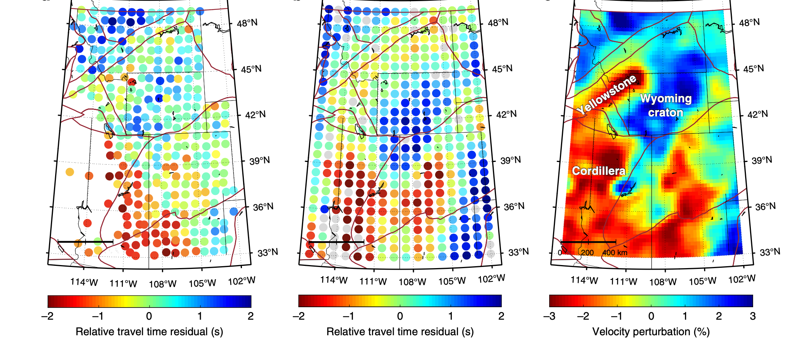
A comparison of P-wave travel time measurements
Chen et al., 2019
Notes:
A comparison of P-wave travel time measurements between the original and reconstructed data. a Relative travel time residuals across the recording array measured from the original data. b Relative travel time residuals measured from the reconstructed data. Measurements with uncertainties larger than one standard deviation of the cross-correlation error are represented by gray circles in (b). The brown lines indicate the boundaries of major tectonic domains in the western US. c Average P-wave velocity perturbations between 50 and 250 km depths from Schmandt and Lin9

Slide 18
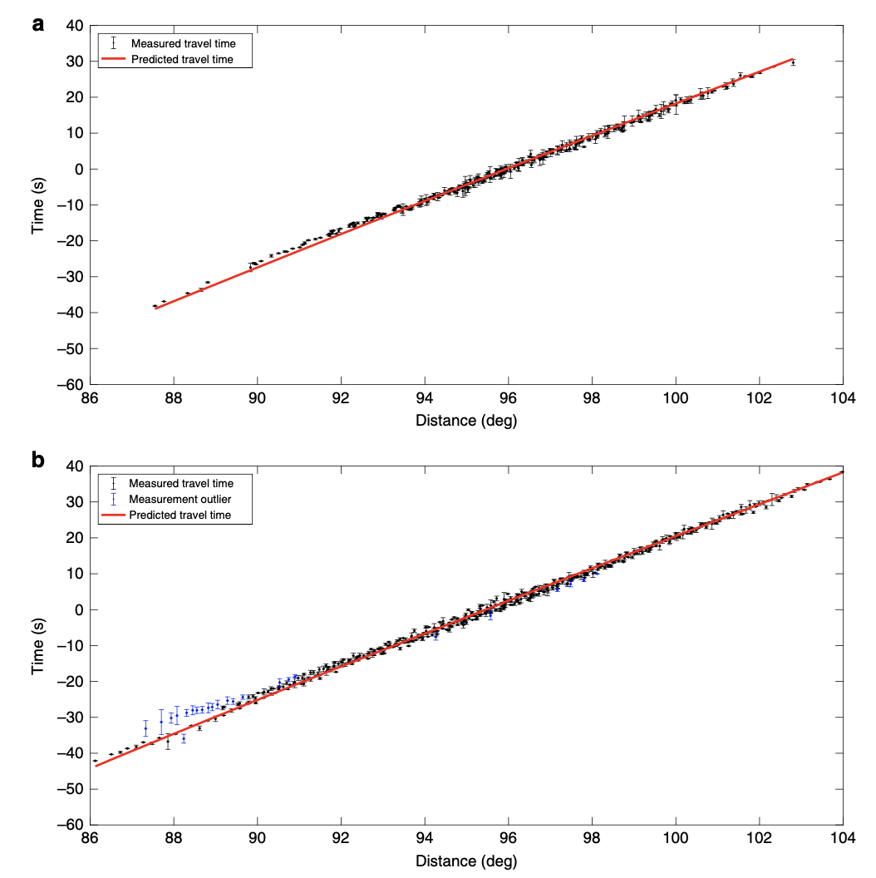
A comparison of travel time measurement uncertainties
Chen et al., 2019
Notes:
A comparison of travel time measurement uncertainties. a Travel time plot of the original data. b Travel time plot of the reconstructed data. Both measured and predicted travel times are demeaned to emphasize the perturbations. The blue data points in (b) represent measurement outliers differing by more than 2 s from the predictions, which are excluded from tomographic inversion in real practice

Slide 19
Future works
1. Deep learning methods for improving the reconstruction (data is available)
2. Improving the existing results (fully reproducible, github)
https://github.com/chenyk1990/reproducible_research/tree/master/usarray
3. Data binning is a step that could introduce error, which can be avoid.
4. Reverse time migration for imaging the crust boundary (synthetic and real)
5. Reconstruction of receiver function (post-stack method) (this method is pre-stack)
6. Reconstruction of spatially sparse earthquake data (TexNet)

Slide 20
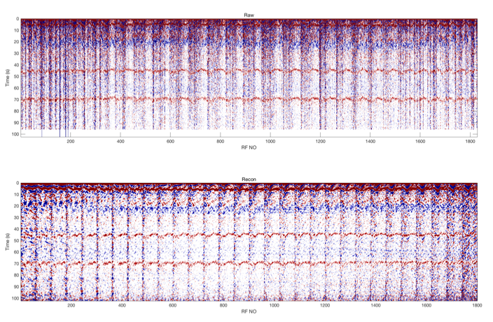
Receiver function image of USArray
Raw image
Moho
Geometry
410 km
Mantle transition zone
660 km
Reconstructed image
Moho
410 km
Mantle transition zone
660 km
Chen et al., 2022
Notes:
Asterisk
90% sampling ratio

Slide 21
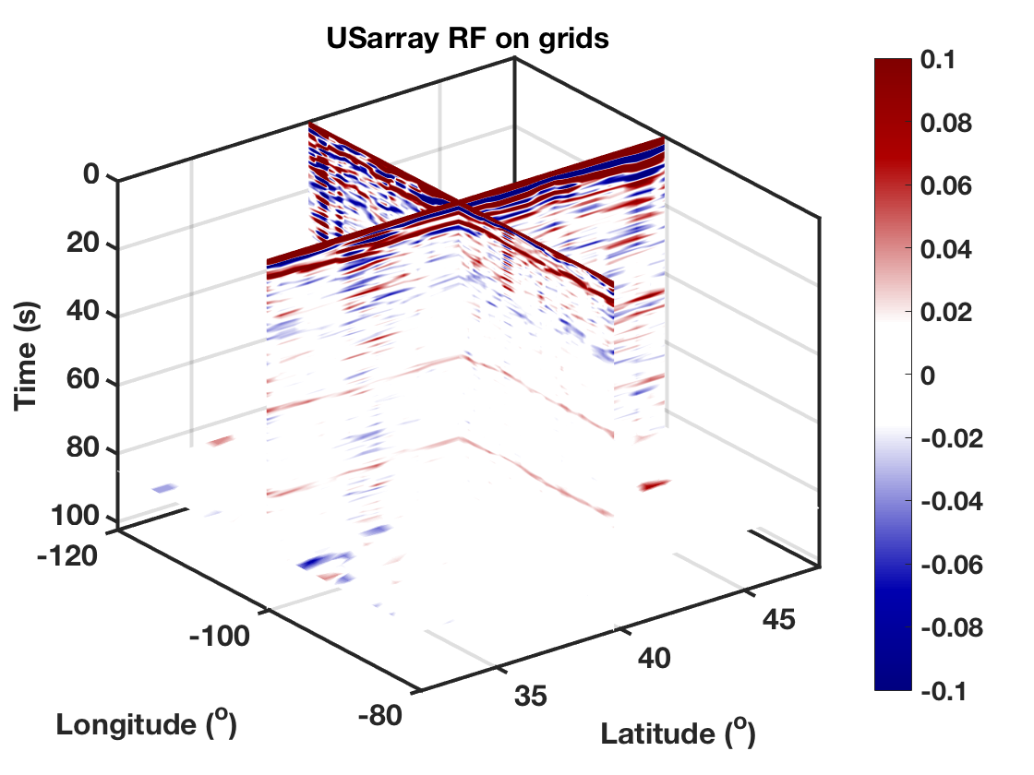
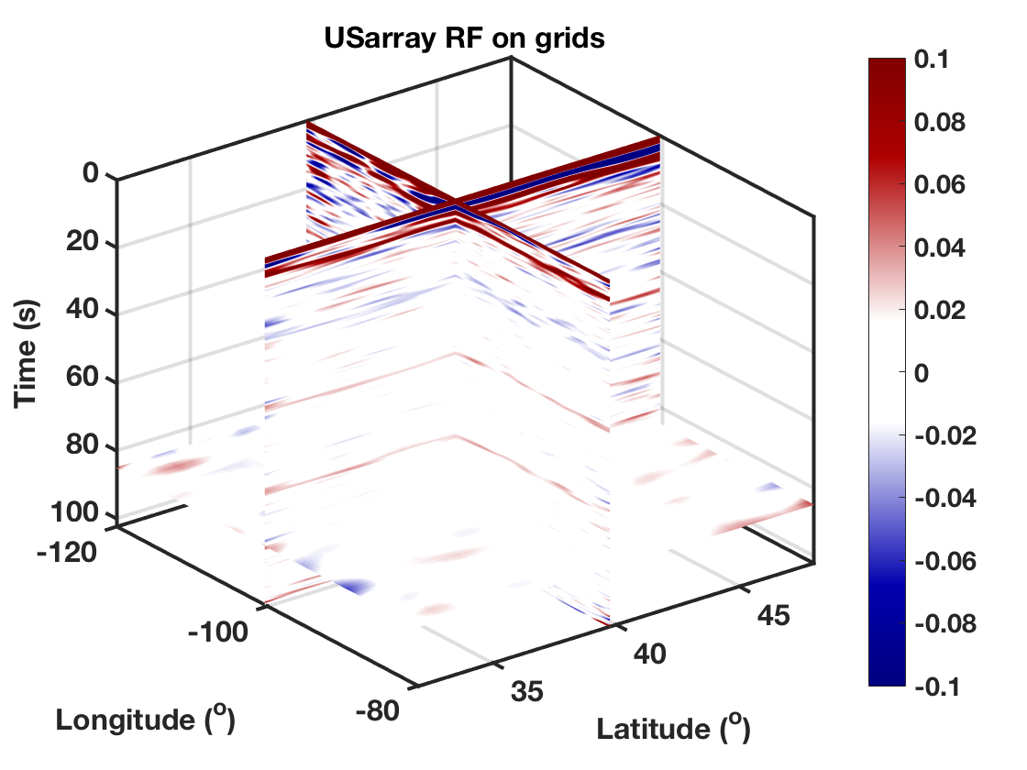
Receiver function image of USArray
Raw image
Reconstructed image
Moho
410 km
660 km
Chen et al., 2022

Slide 22
Receiver function images
Moho
410 km
660 km
Raw
Reconstructed
Raw
Reconstructed
Chen et al., 2022

Slide 23
Receiver function images
Moho
410 km
660 km
Raw
Reconstructed
Raw
Reconstructed
Chen et al., 2022

Slide 24
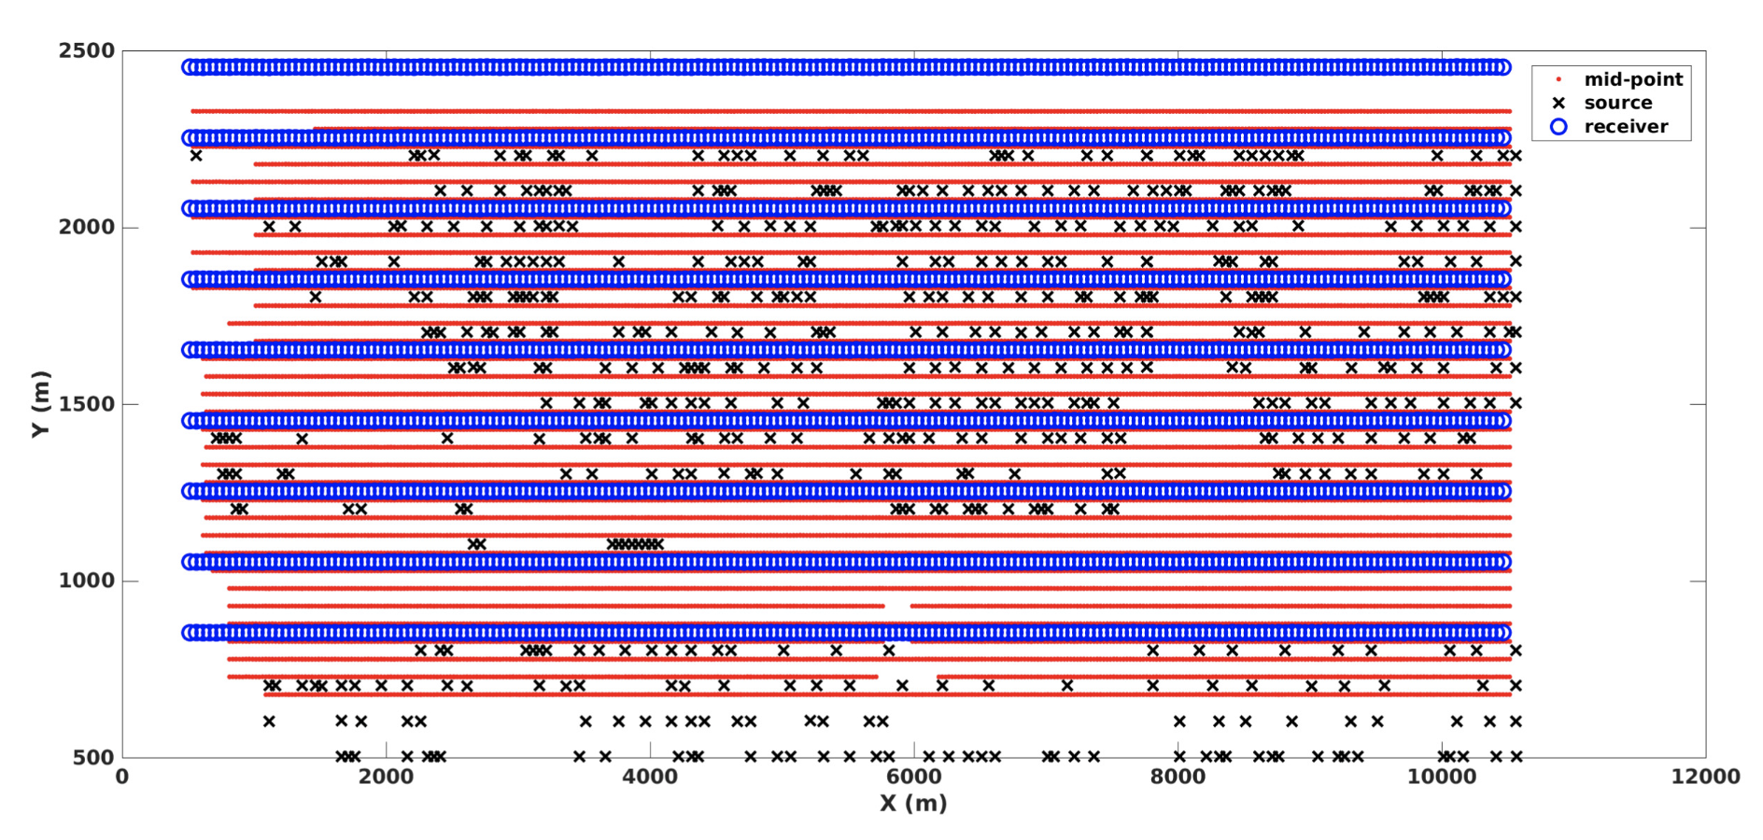
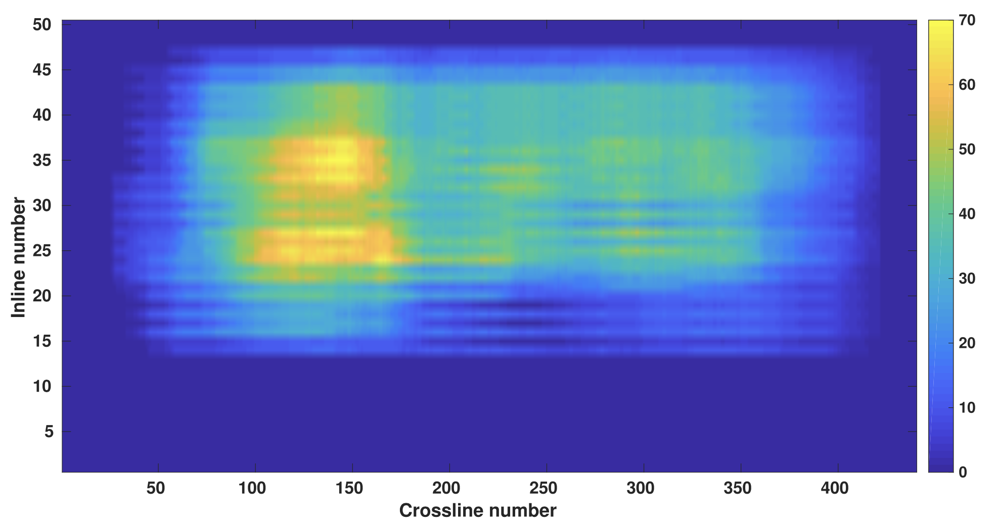
5D interpolation

Slide 25
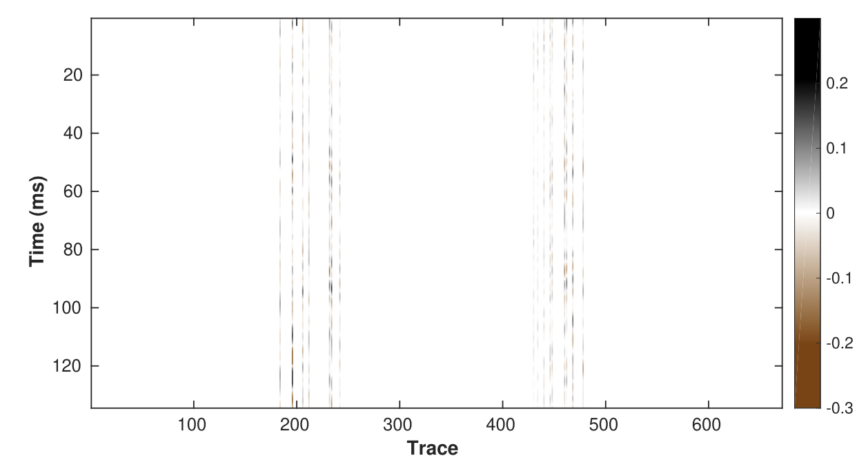
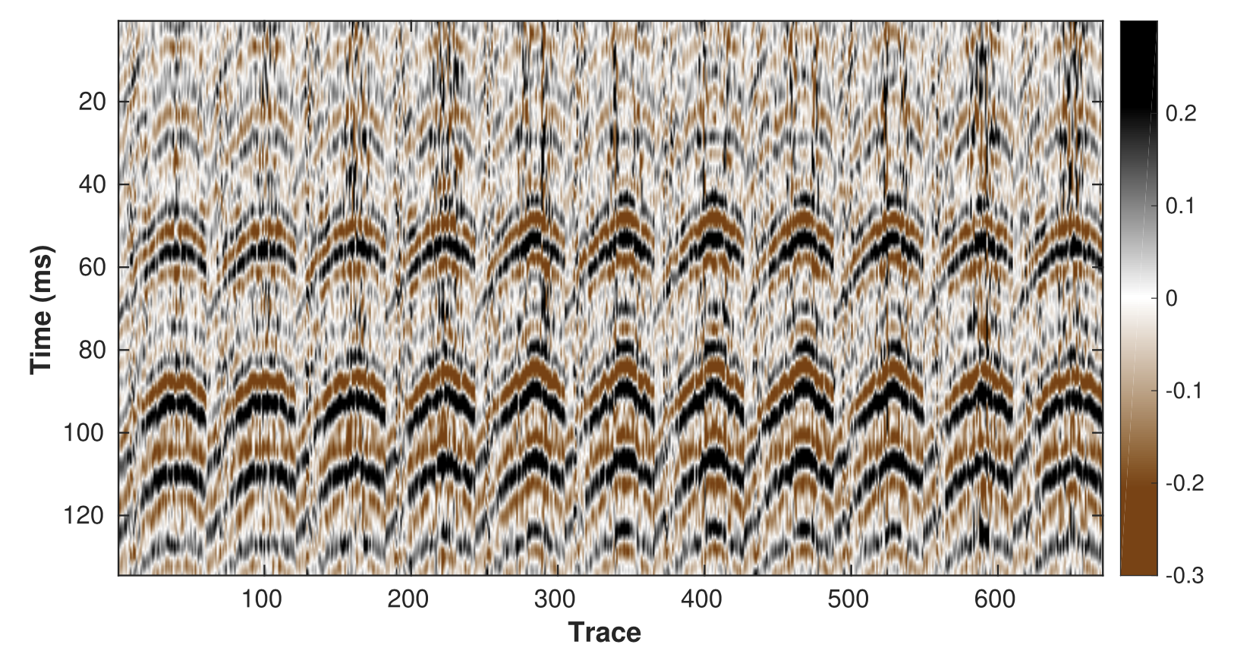
Magic of 5D interpolation
Field 5-D data with 99.76% traces missing.
Reconstructed data

Slide 26
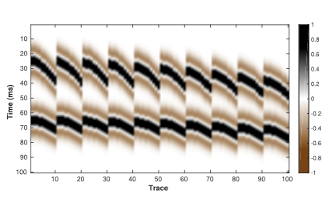
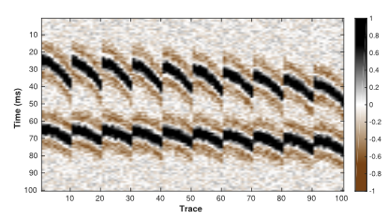
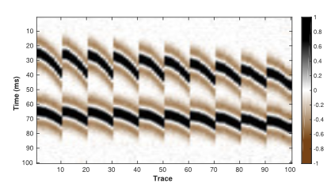
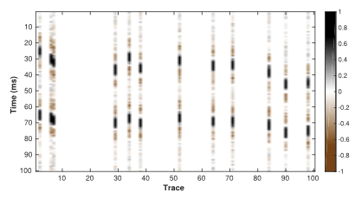
Synthetic test
Clean
Noisy
Observed
Reconstructed

Slide 27
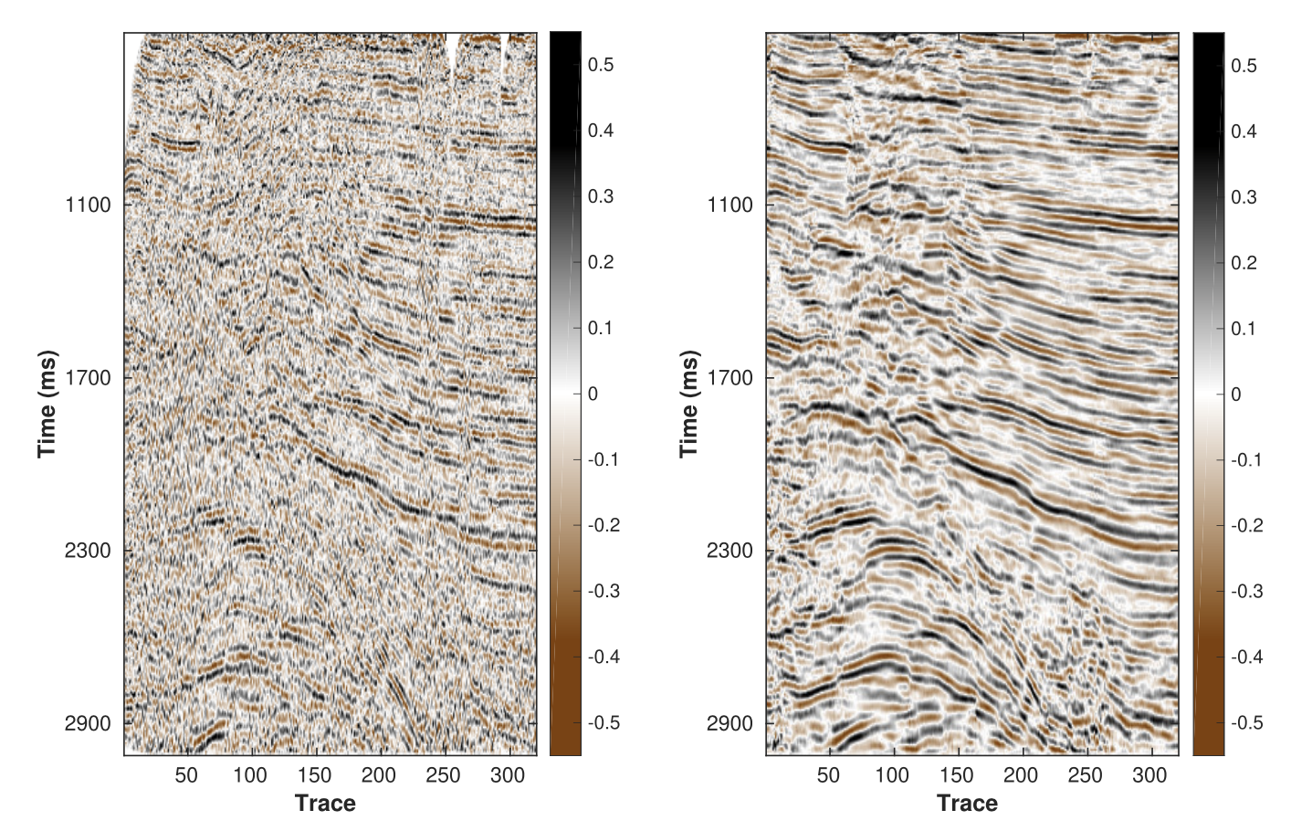
Seismic image comparison

Slide 28
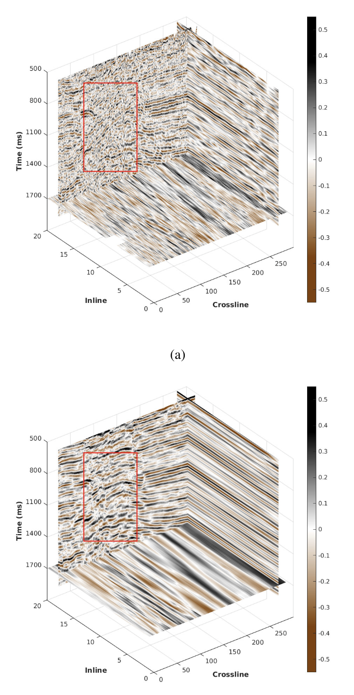
3D comparison
Before
After

Slide 29
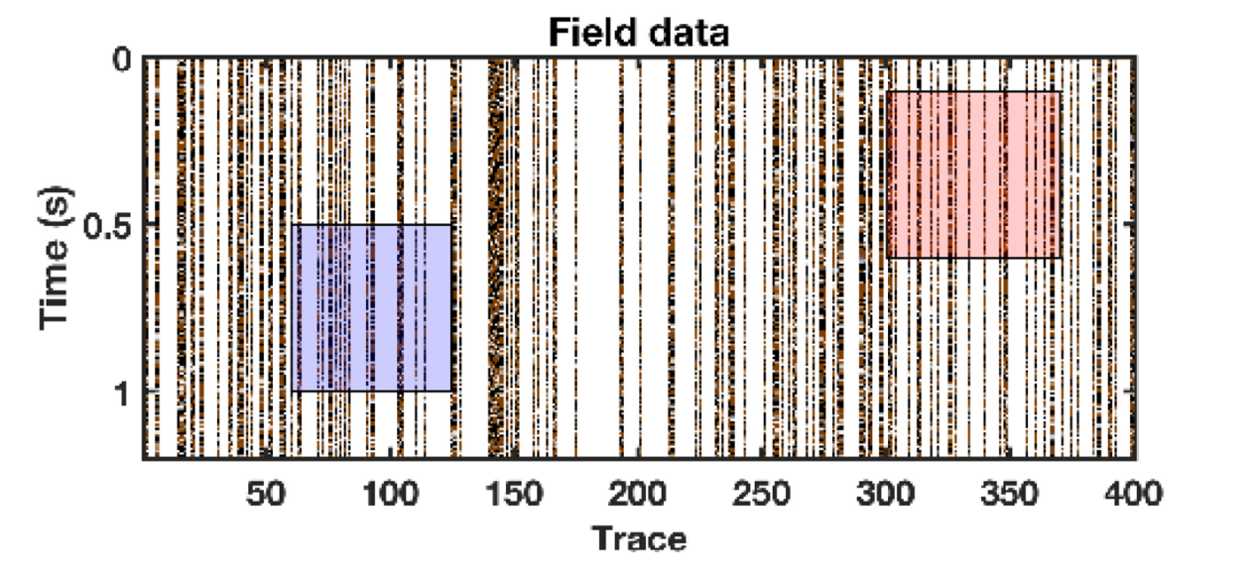
Benchmark comparison through reproducible research

Slide 30
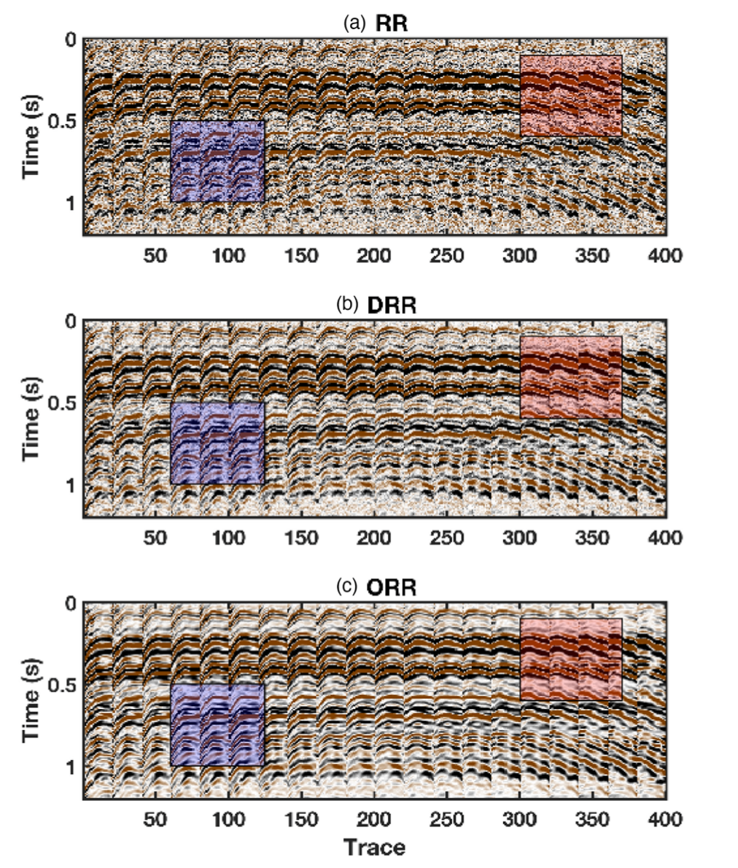

Slide 31
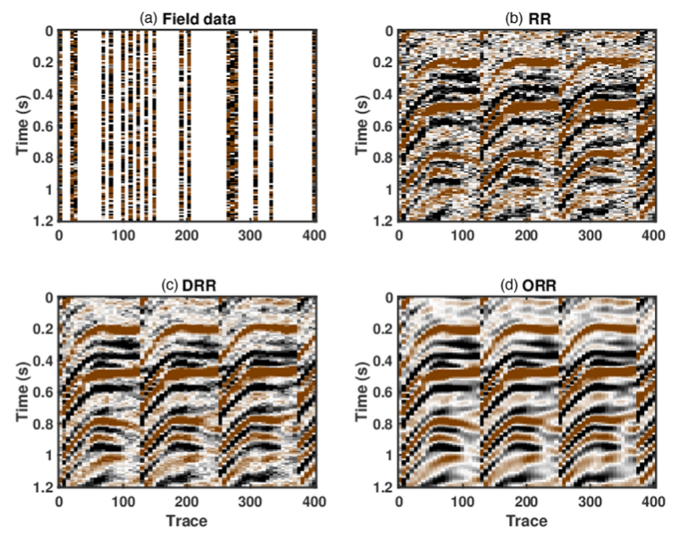
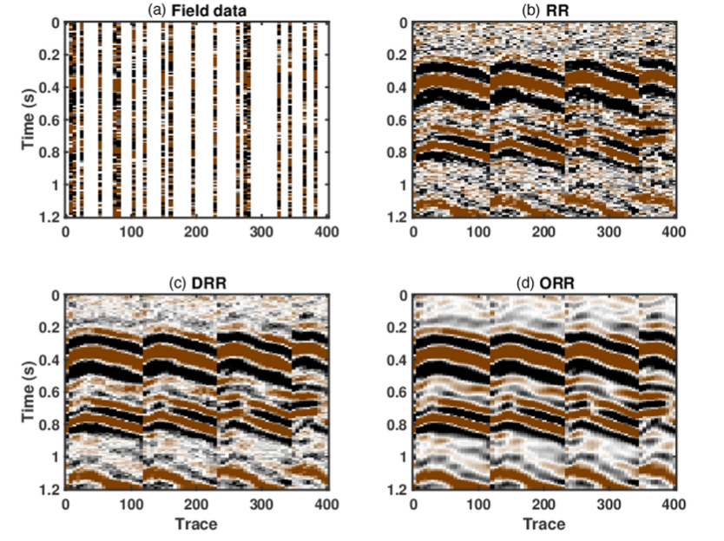

Slide 32
Conclusions
1. Densely sampled earthquake data can be improved significantly via denoising and reconstruction.
2. Earthquake denoising and reconstruction makes a single earthquake shot gather able to infer the earth interior.
3. Signal processing algorithms arising from exploration seismology plays an important role in earthquake seismology.
4. Further studies like 4D/5D reconstruction, seismic migration on earthquake data are very promising.
5. There are massive FREE earthquake data from around the world, we can make full use of them.

